Slide 1
KS3 Electricity Lesson 6
Resistance

Slide 2
Learning Objective
To investigate resistance in circuits.
Success Criteria
To recall the definition of resistance.
To carry out an investigation to determine how changing a variable can affect the resistance in a wire.
To calculate the resistance of data from a given formula.

Slide 3

Starter: Circuit Symbol Bingo
Choose four words from the following list and write them in the spaces on the grid:
You will hear a definition of each component. Cross off your word if you think you have the correct answer.
bulb, open switch, closed switch, ammeter, voltmeter, motor, battery and conductor.

Slide 4

Resistance
What is resistance?
Resistance is measured in Ohms (Ω).
Why might these factors affect the resistance in a wire?
Resistance is a measure of how easy it is for the current to flow around a circuit.
The higher the resistance, the lower the current that will flow around the circuit. The higher the current flow around the circuit, the lower the resistance.
temperature
width of a wire
length of a wire
material
Conductors have low resistance as they allow a flow of charges to pass through them. Insulators have high resistance as it is difficult for a flow of charges to pass through them.

Slide 5
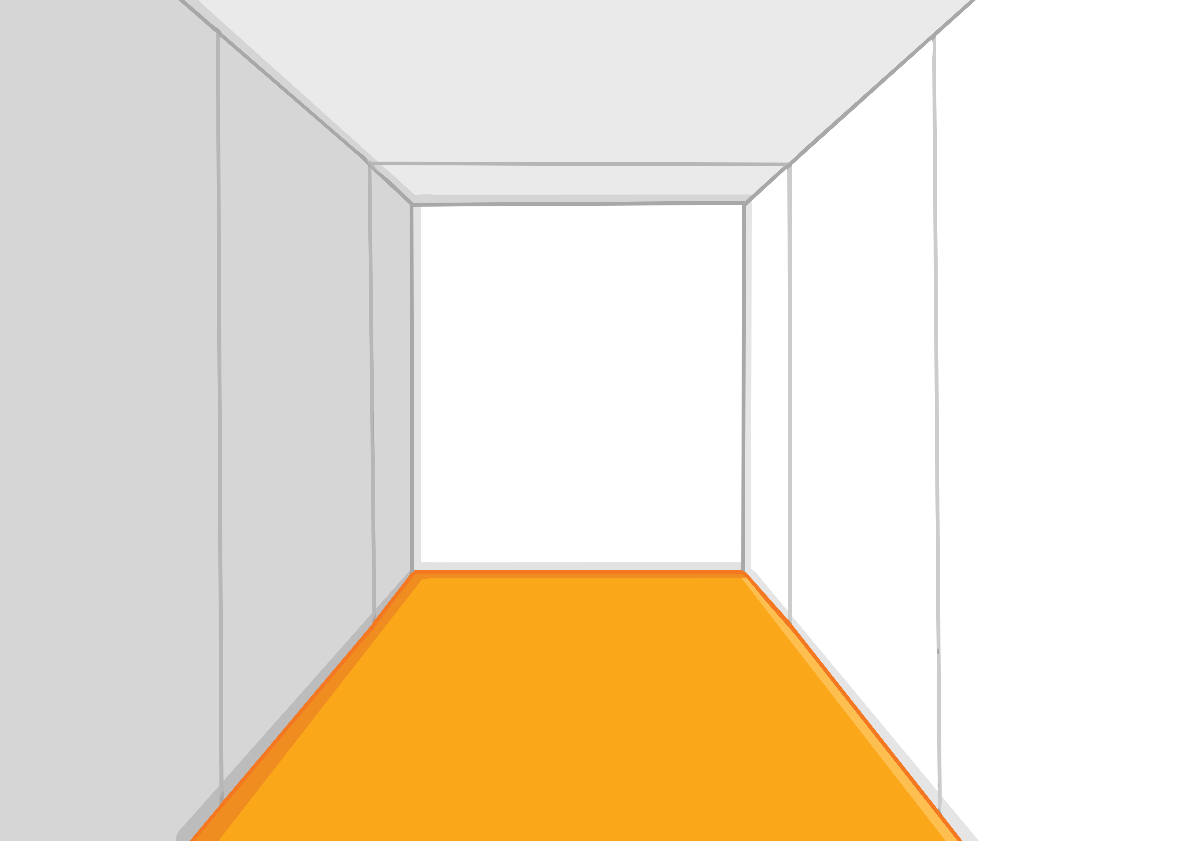
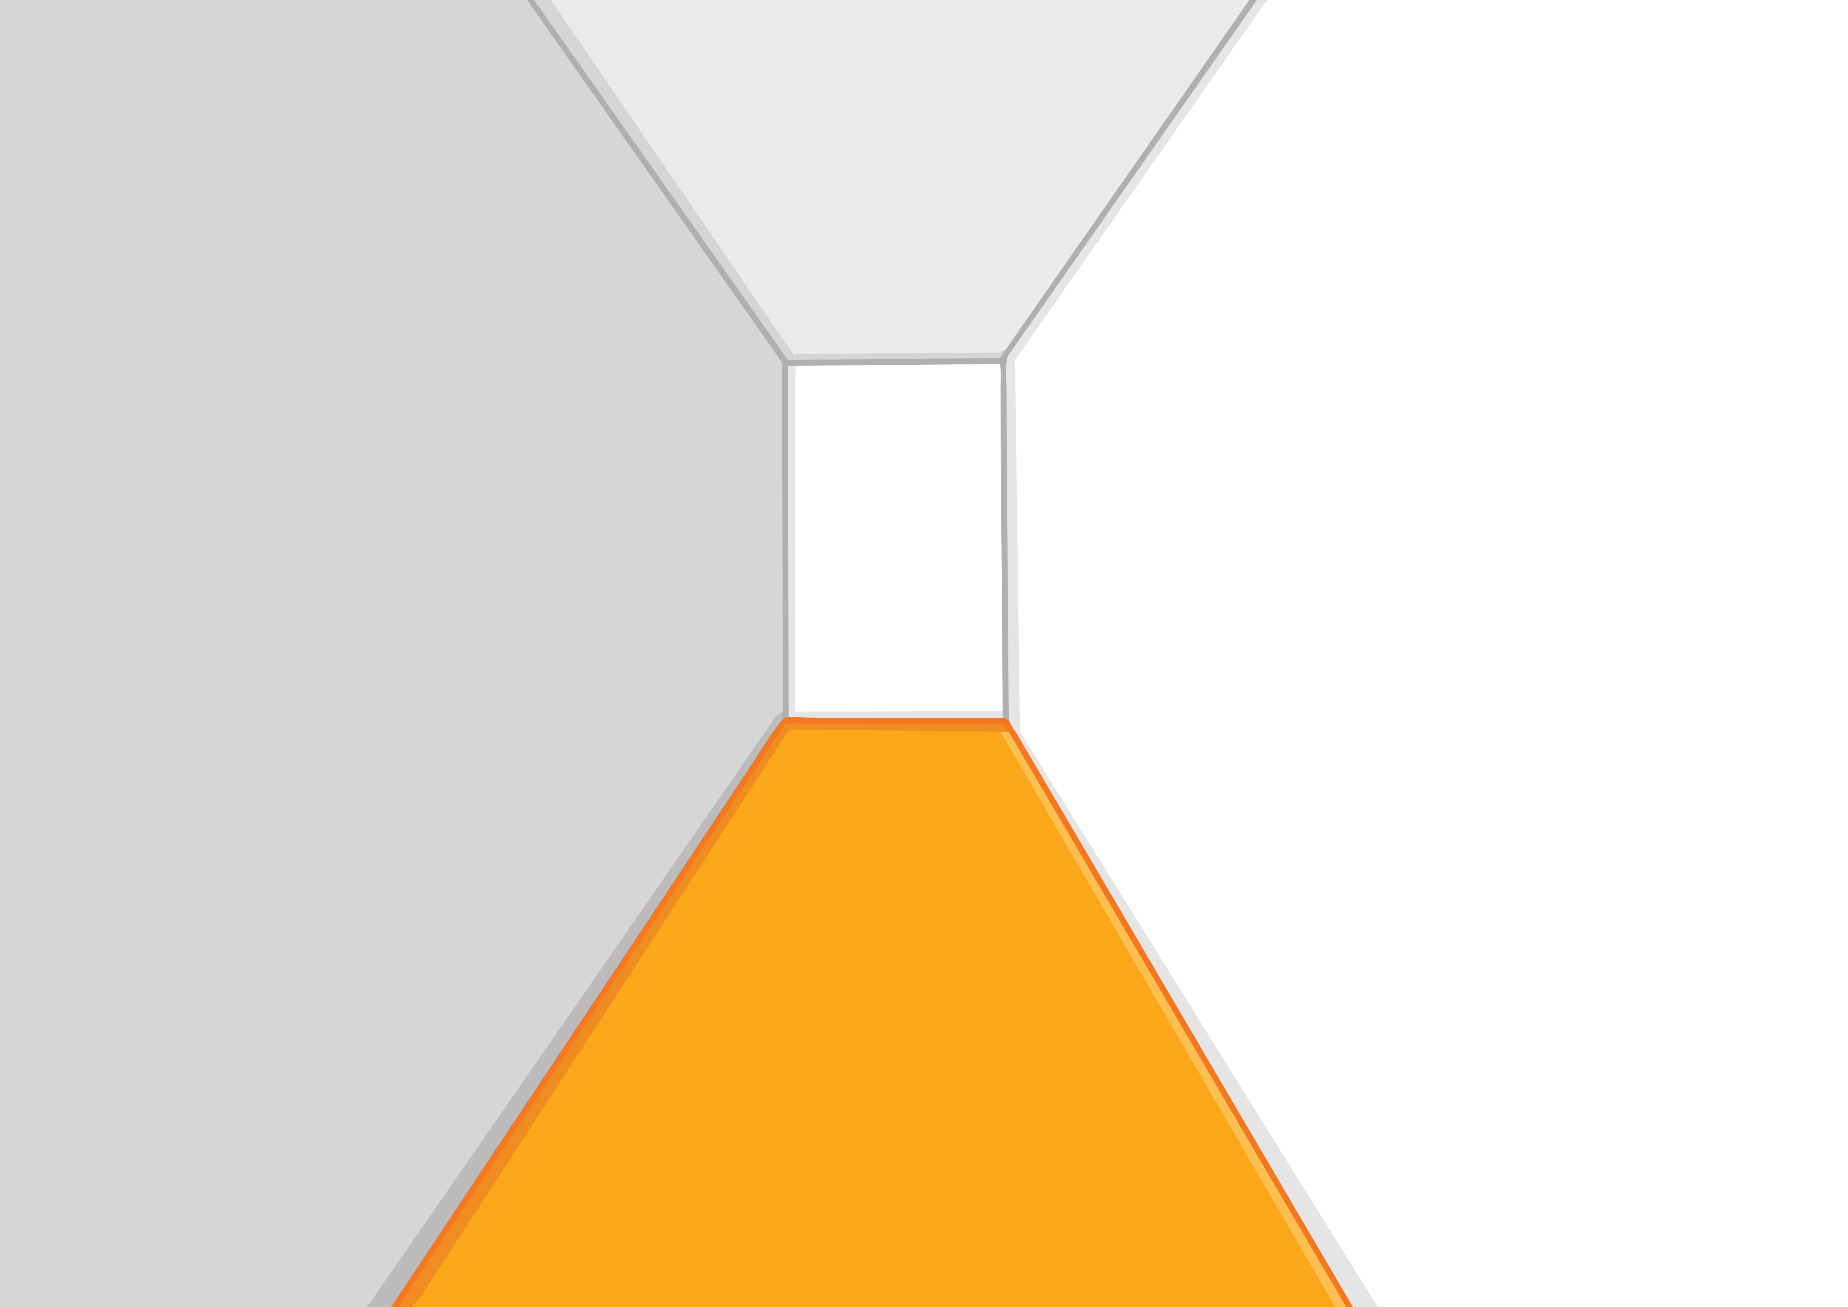


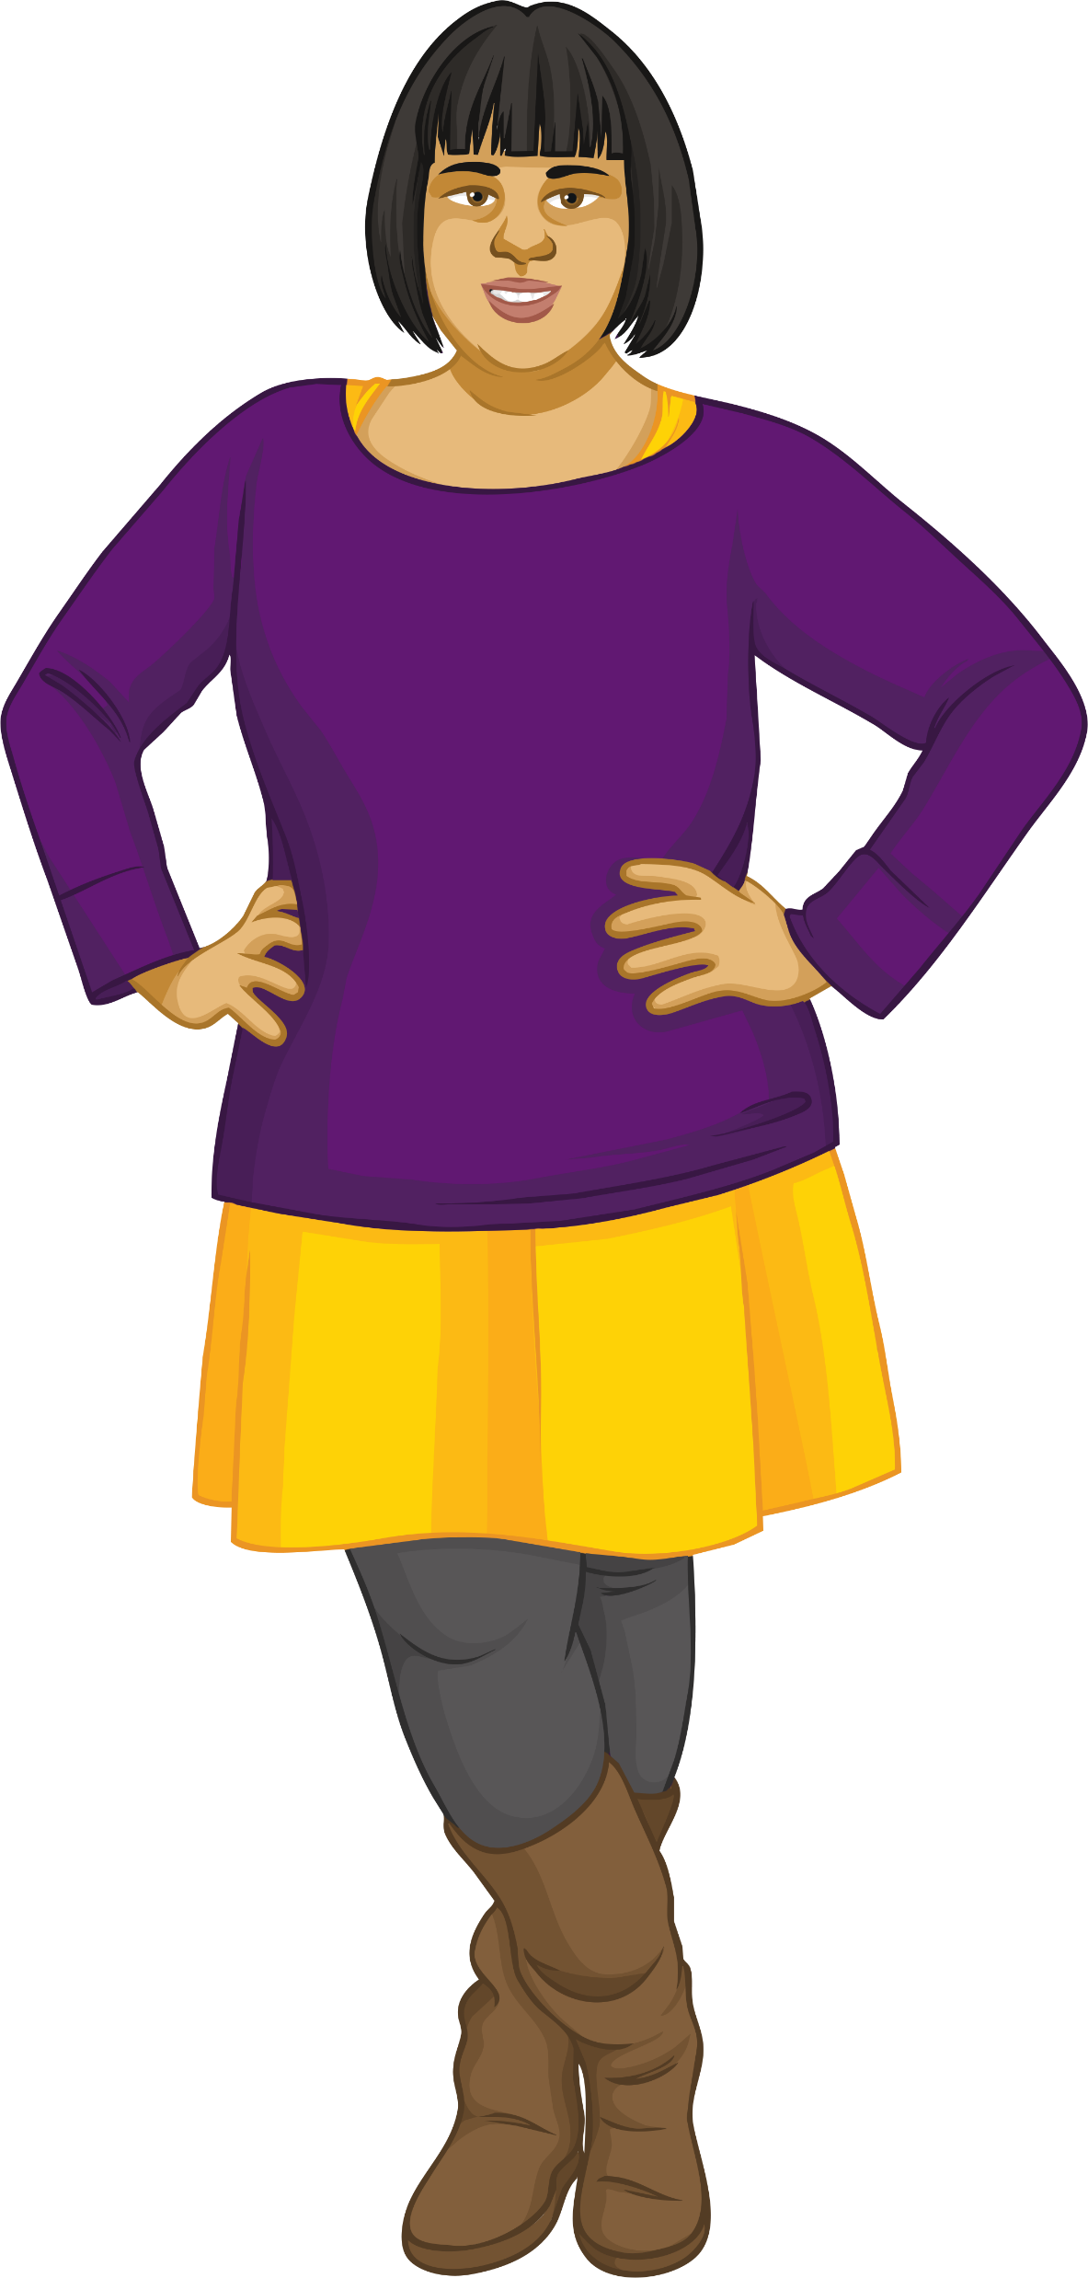
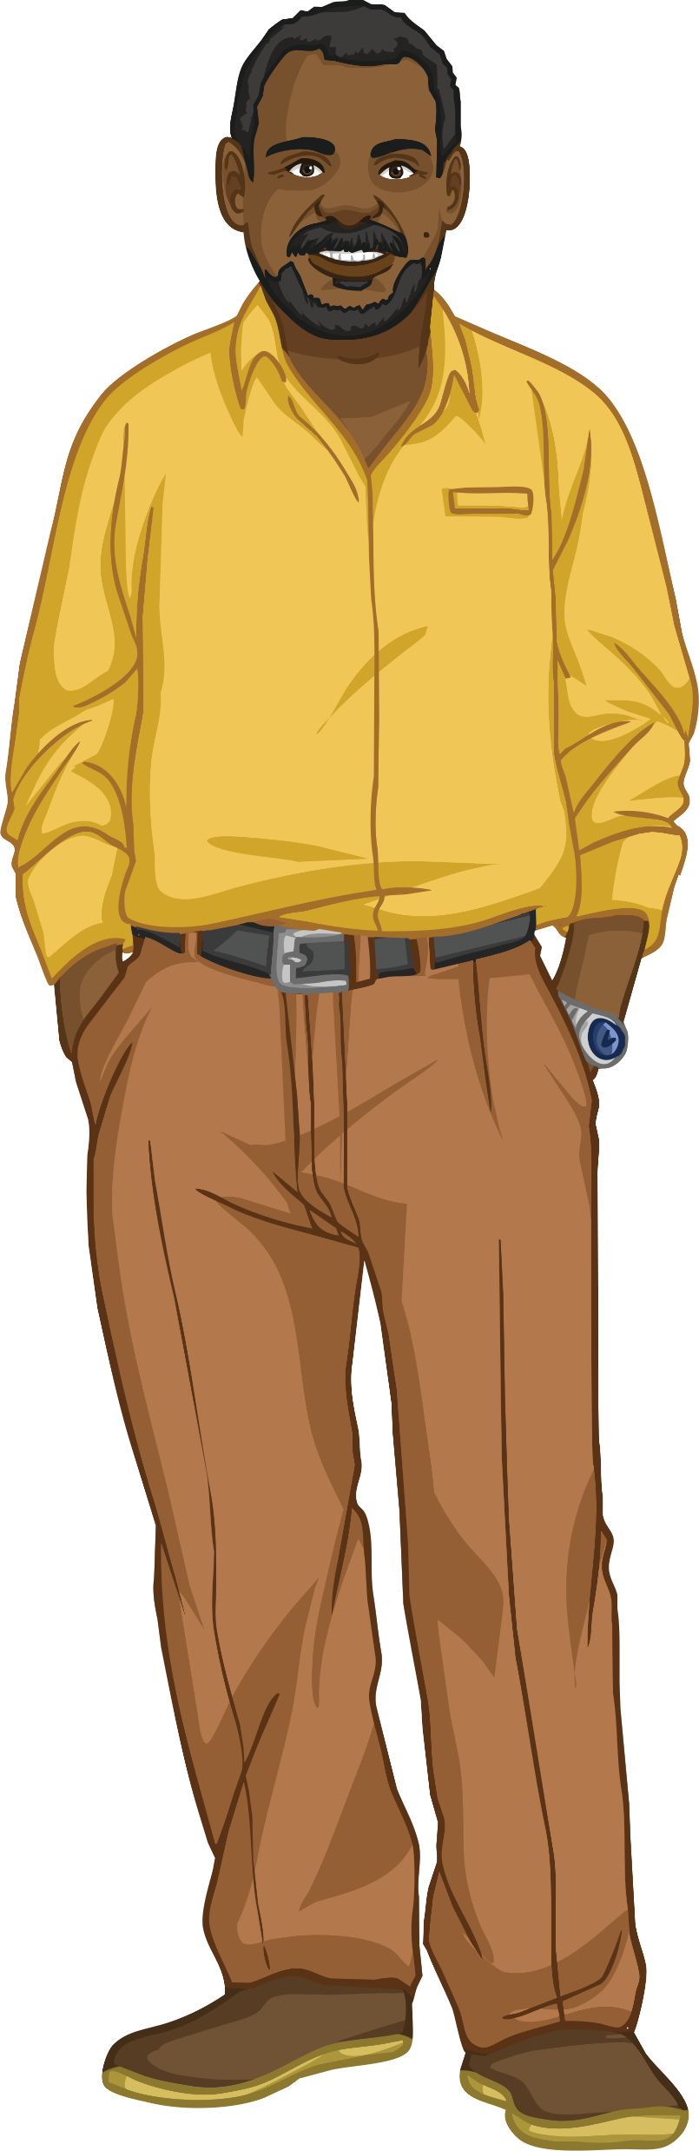
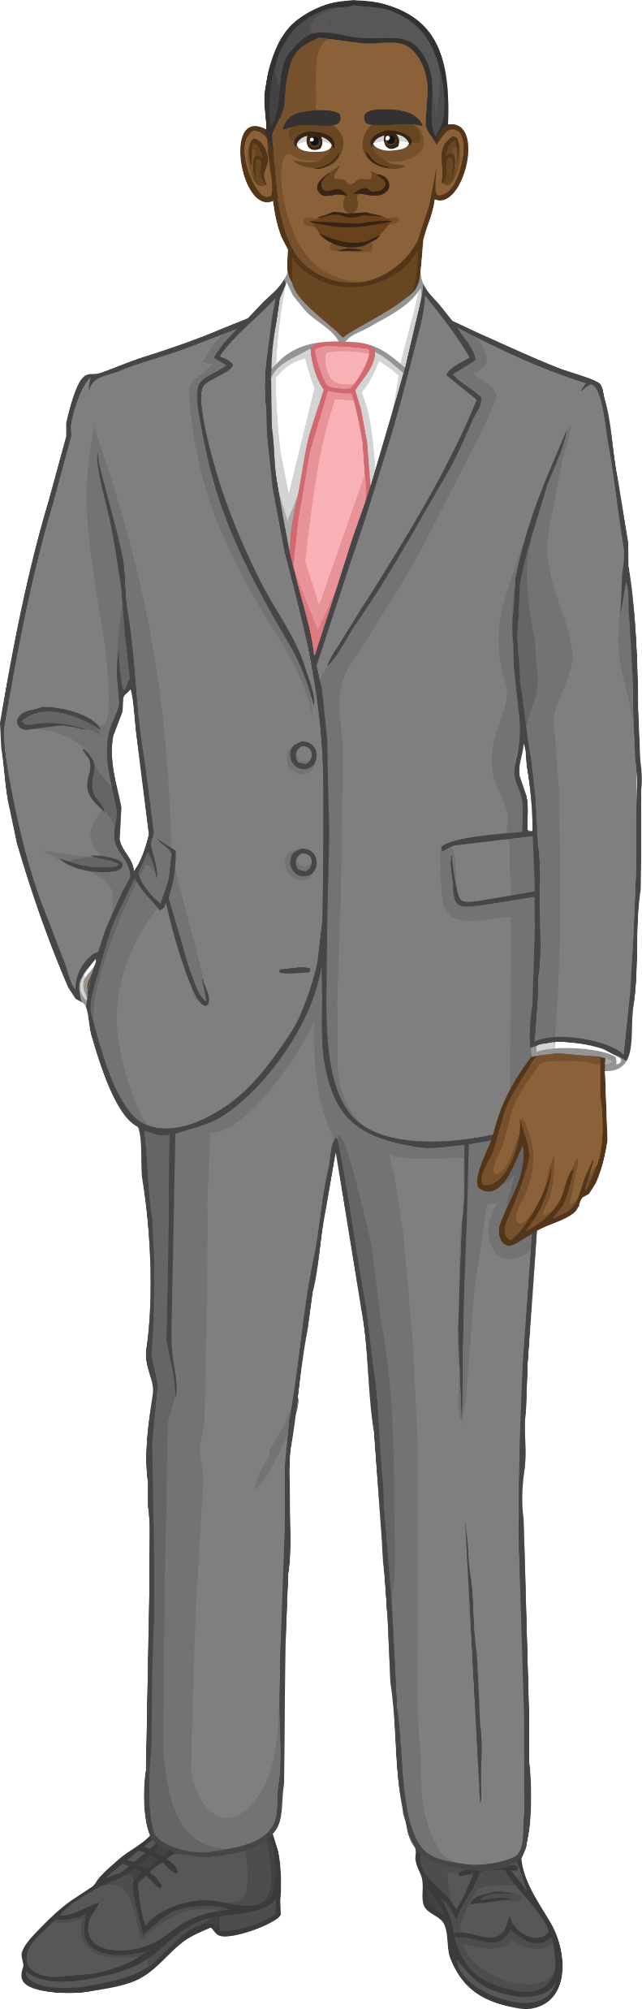
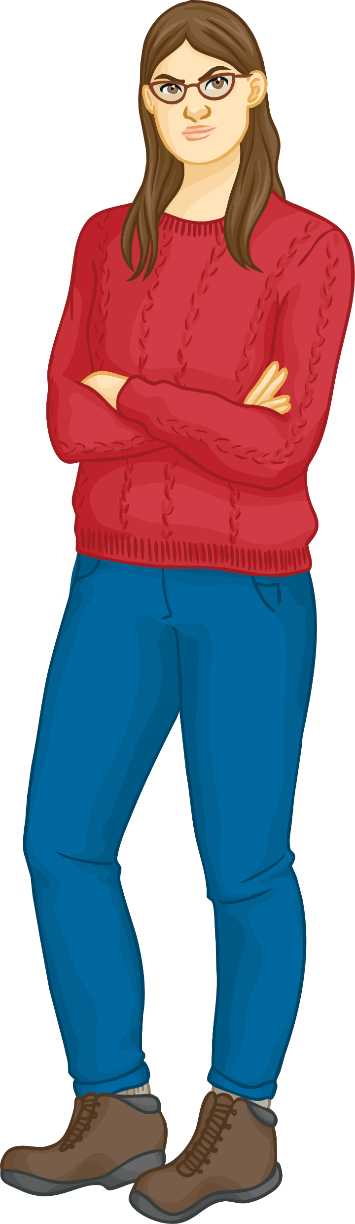
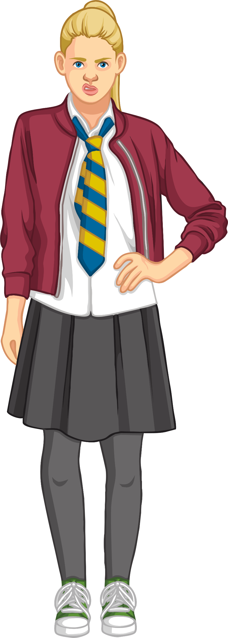

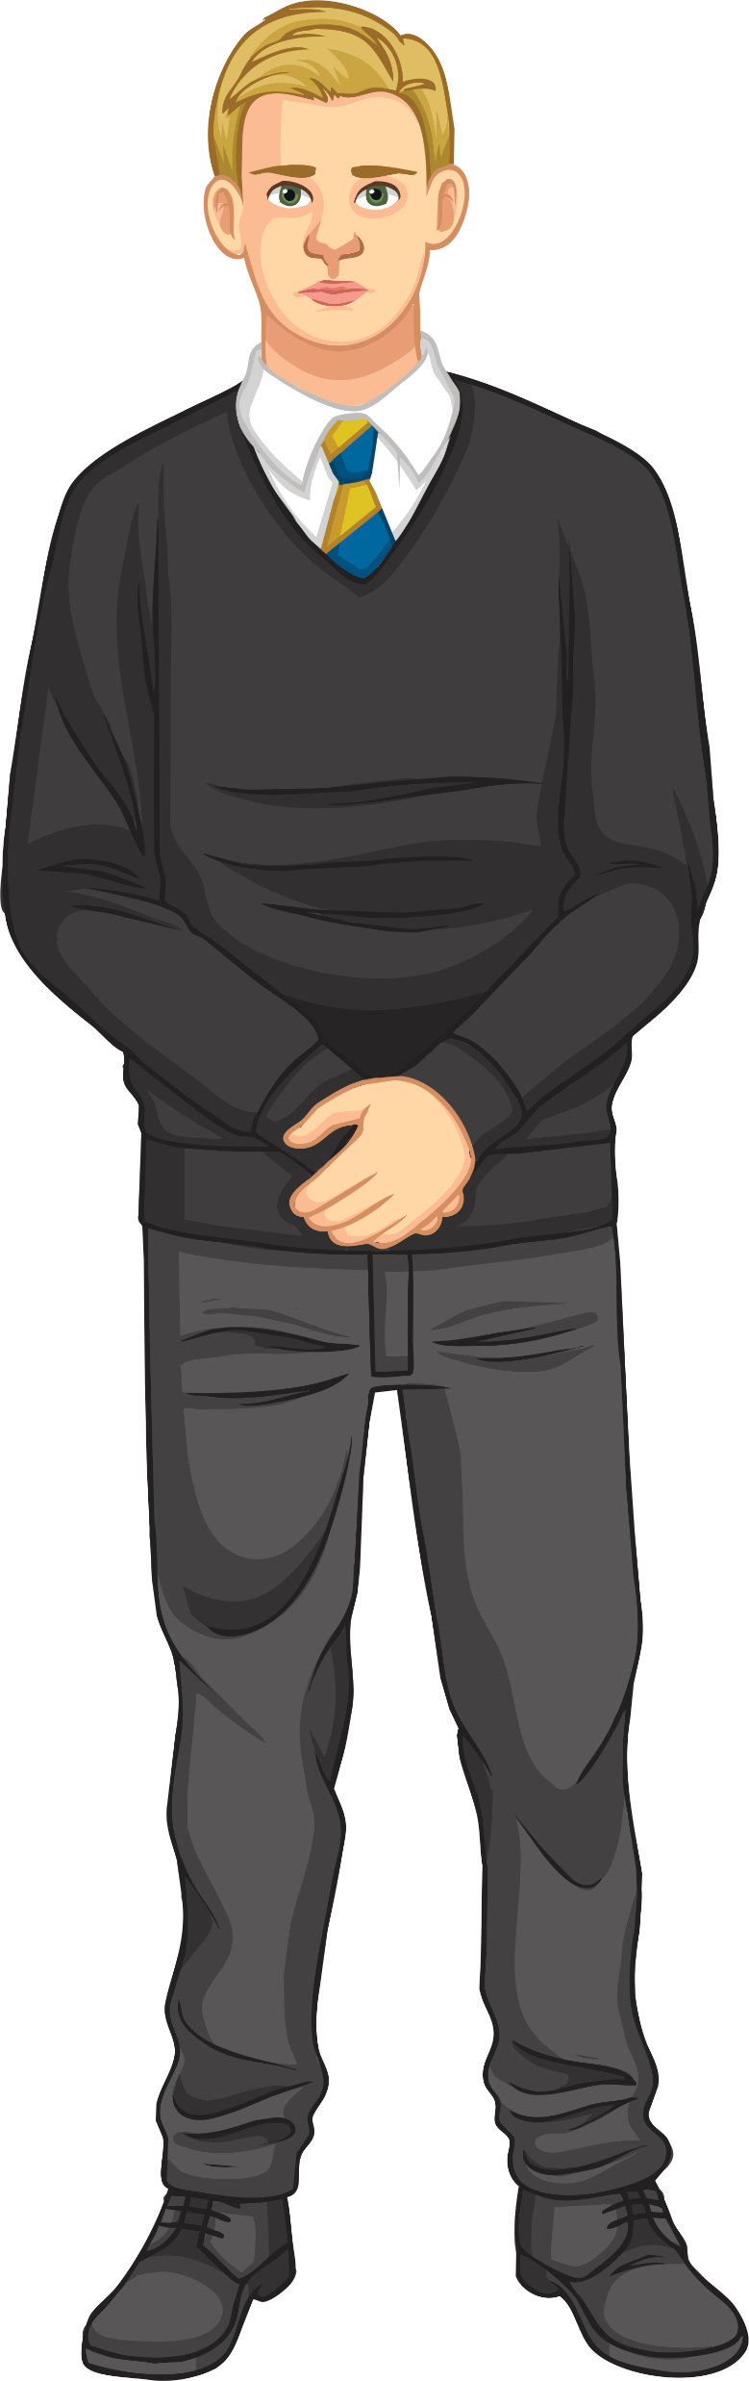

Models of Resistance
How can we model resistance in a wire?
What are the strengths and weaknesses of the model below?

Slide 6

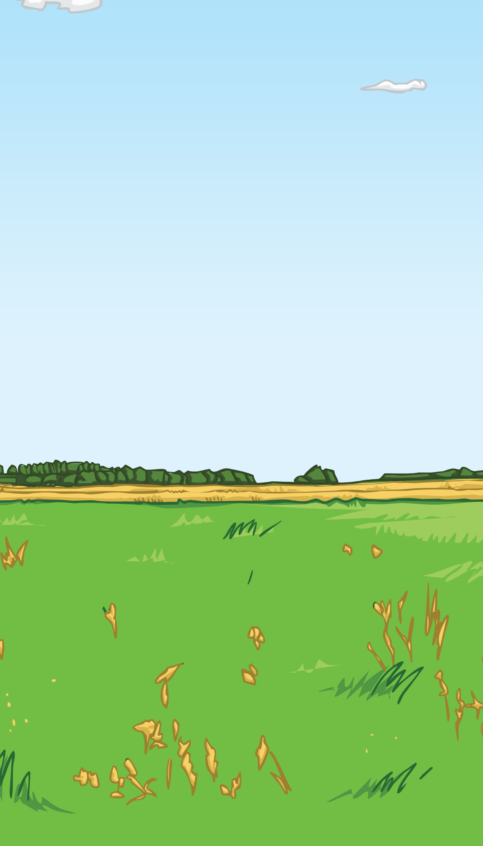
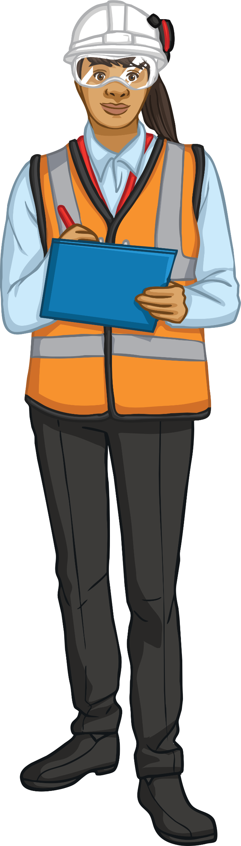
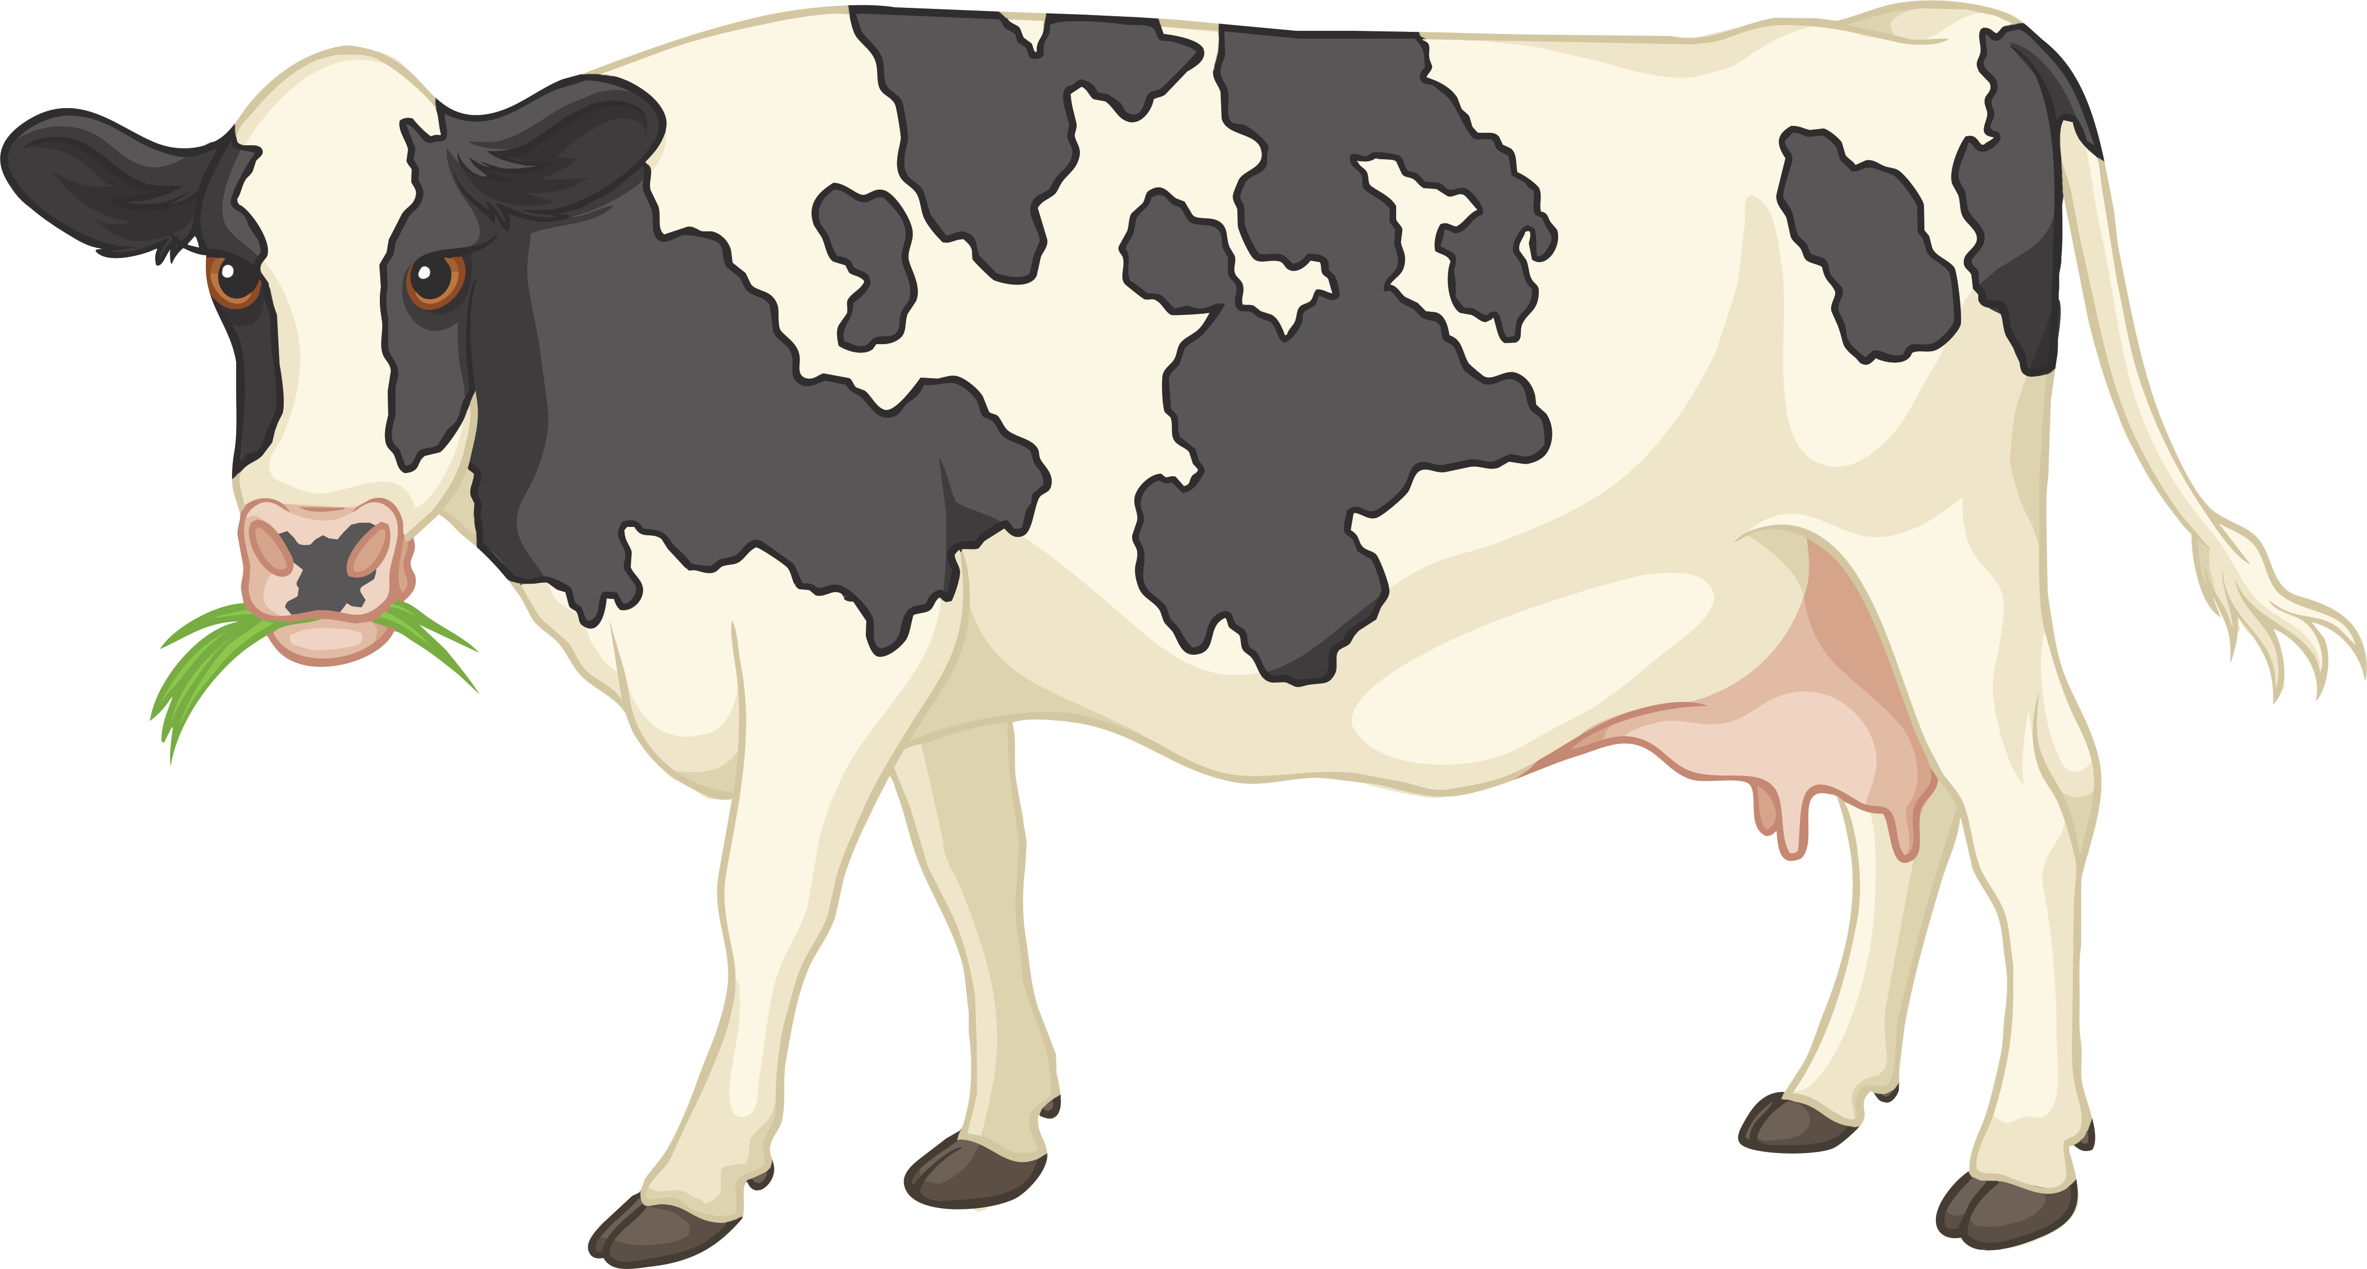
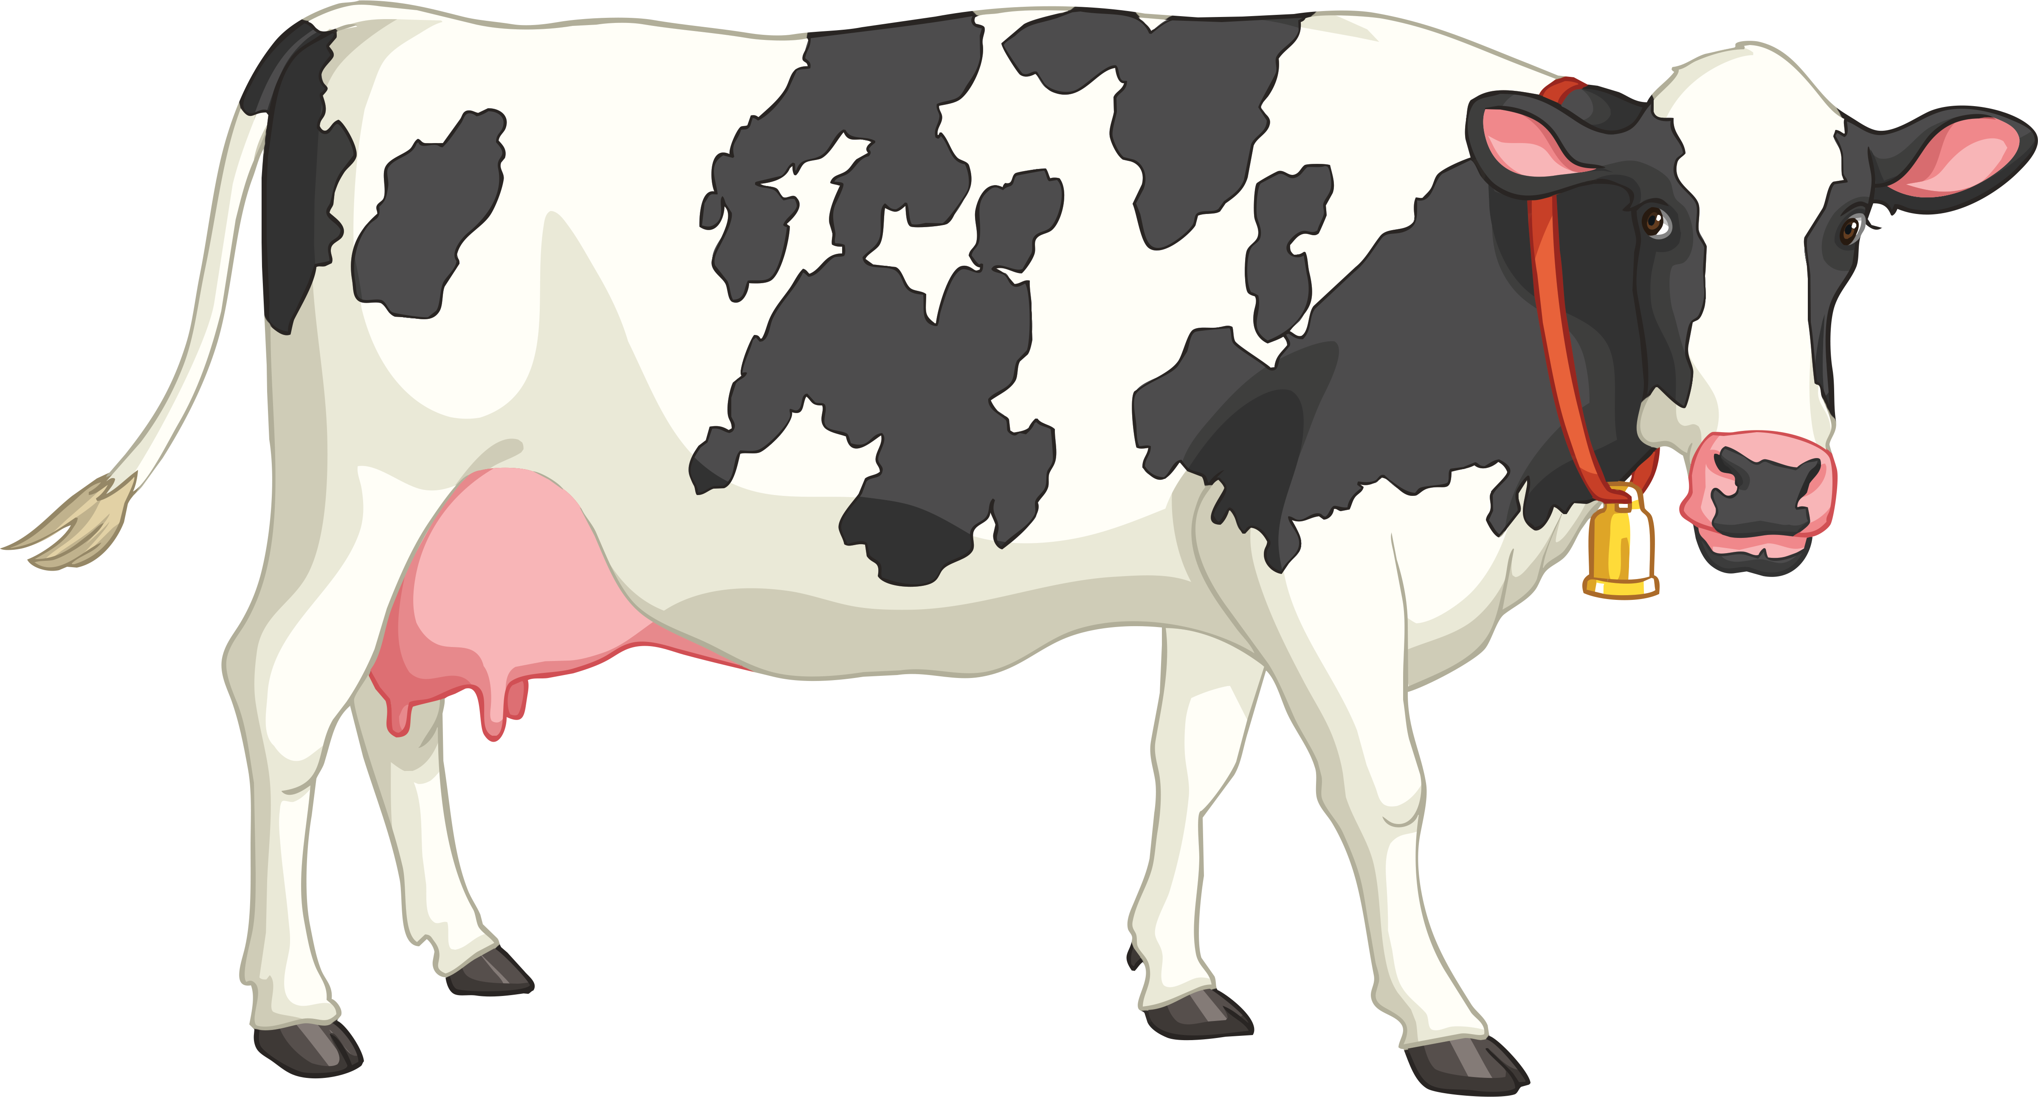
Resistance Investigation
You are working for a local farming company as an electrical engineer fitting electric fences. The electric fence in the cow field has recently blown down during a storm. You need to fence off the cow field, but for safety reasons you can only use 3V of electrical energy. You need to select a wire that will carry the maximum amount of current.
You have been asked to test the resistance of five different lengths of wire with the aim of finding the length of wire that has the lowest resistance.
The farming company, as an additional task, would like you to calculate the resistance of each of the five lengths of wire. The results of this test will help the company to select the lengths of wire they will use for other animal pens on the farm.

Slide 7
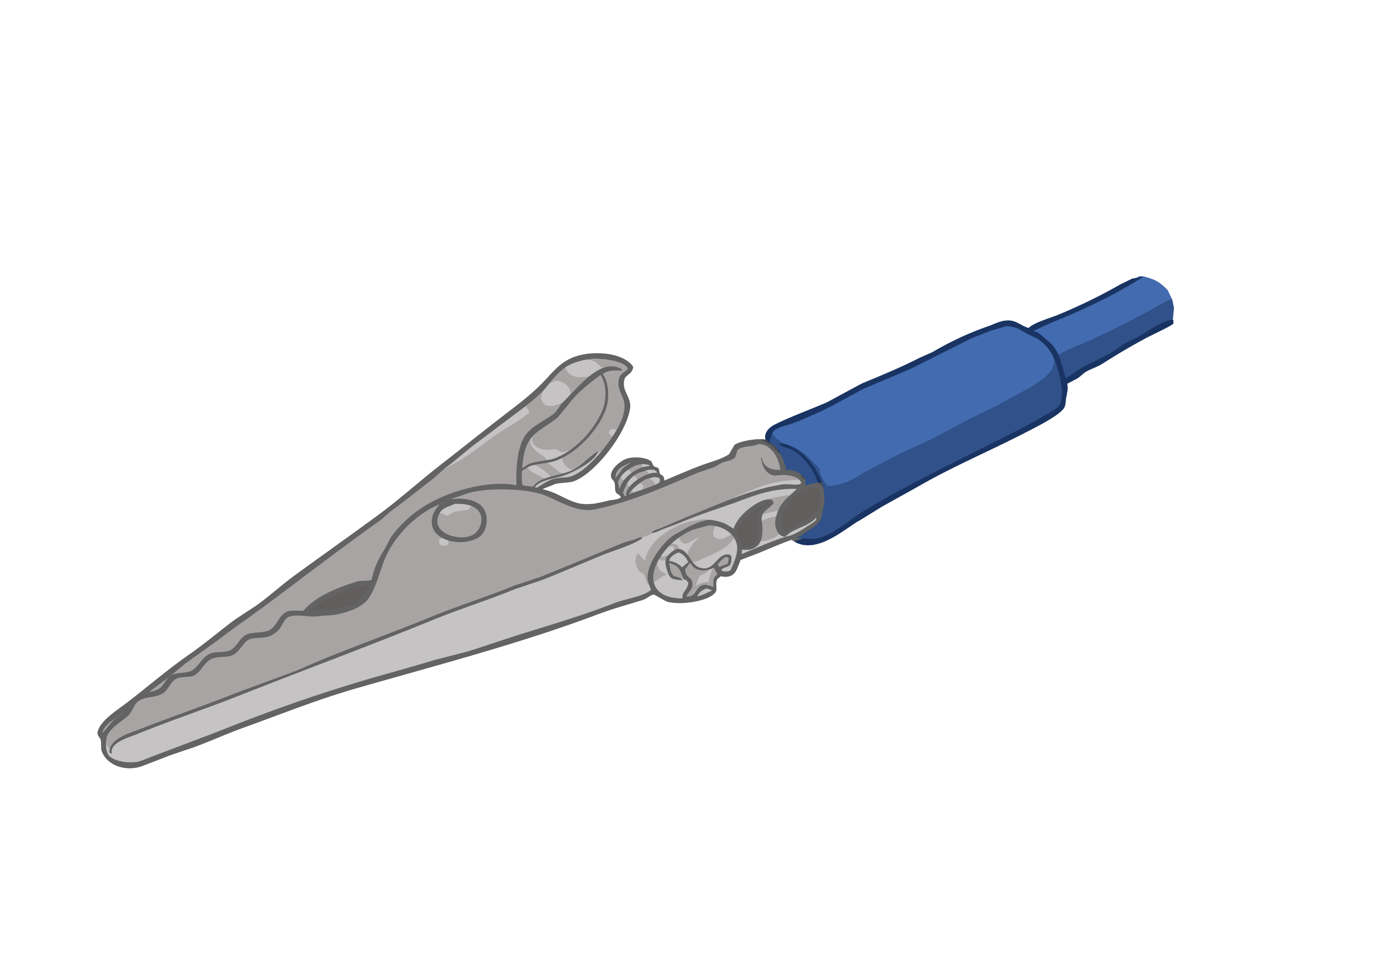
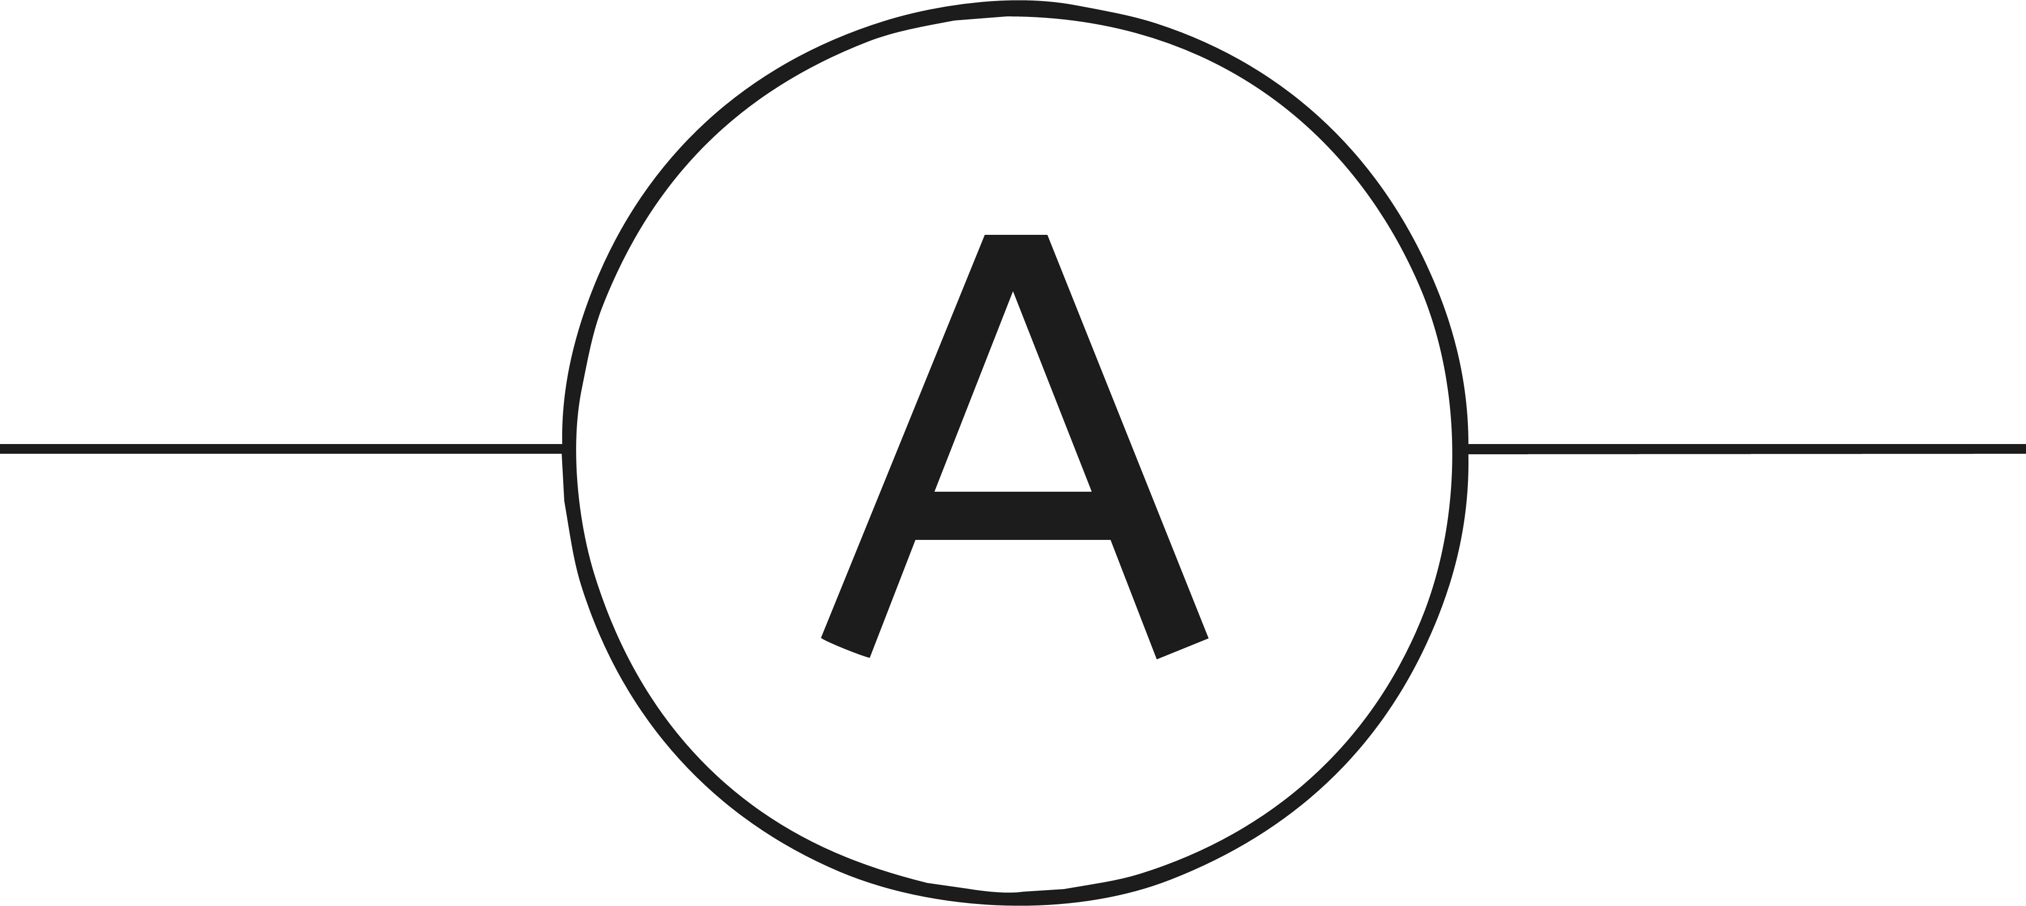
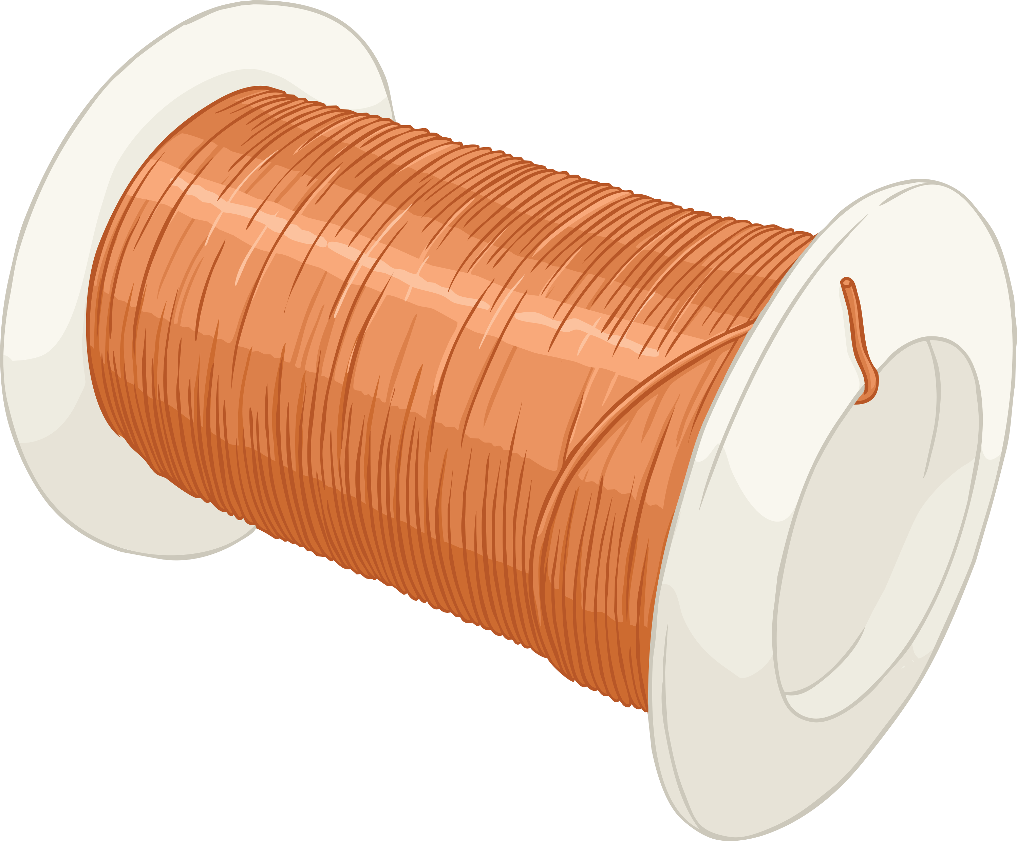
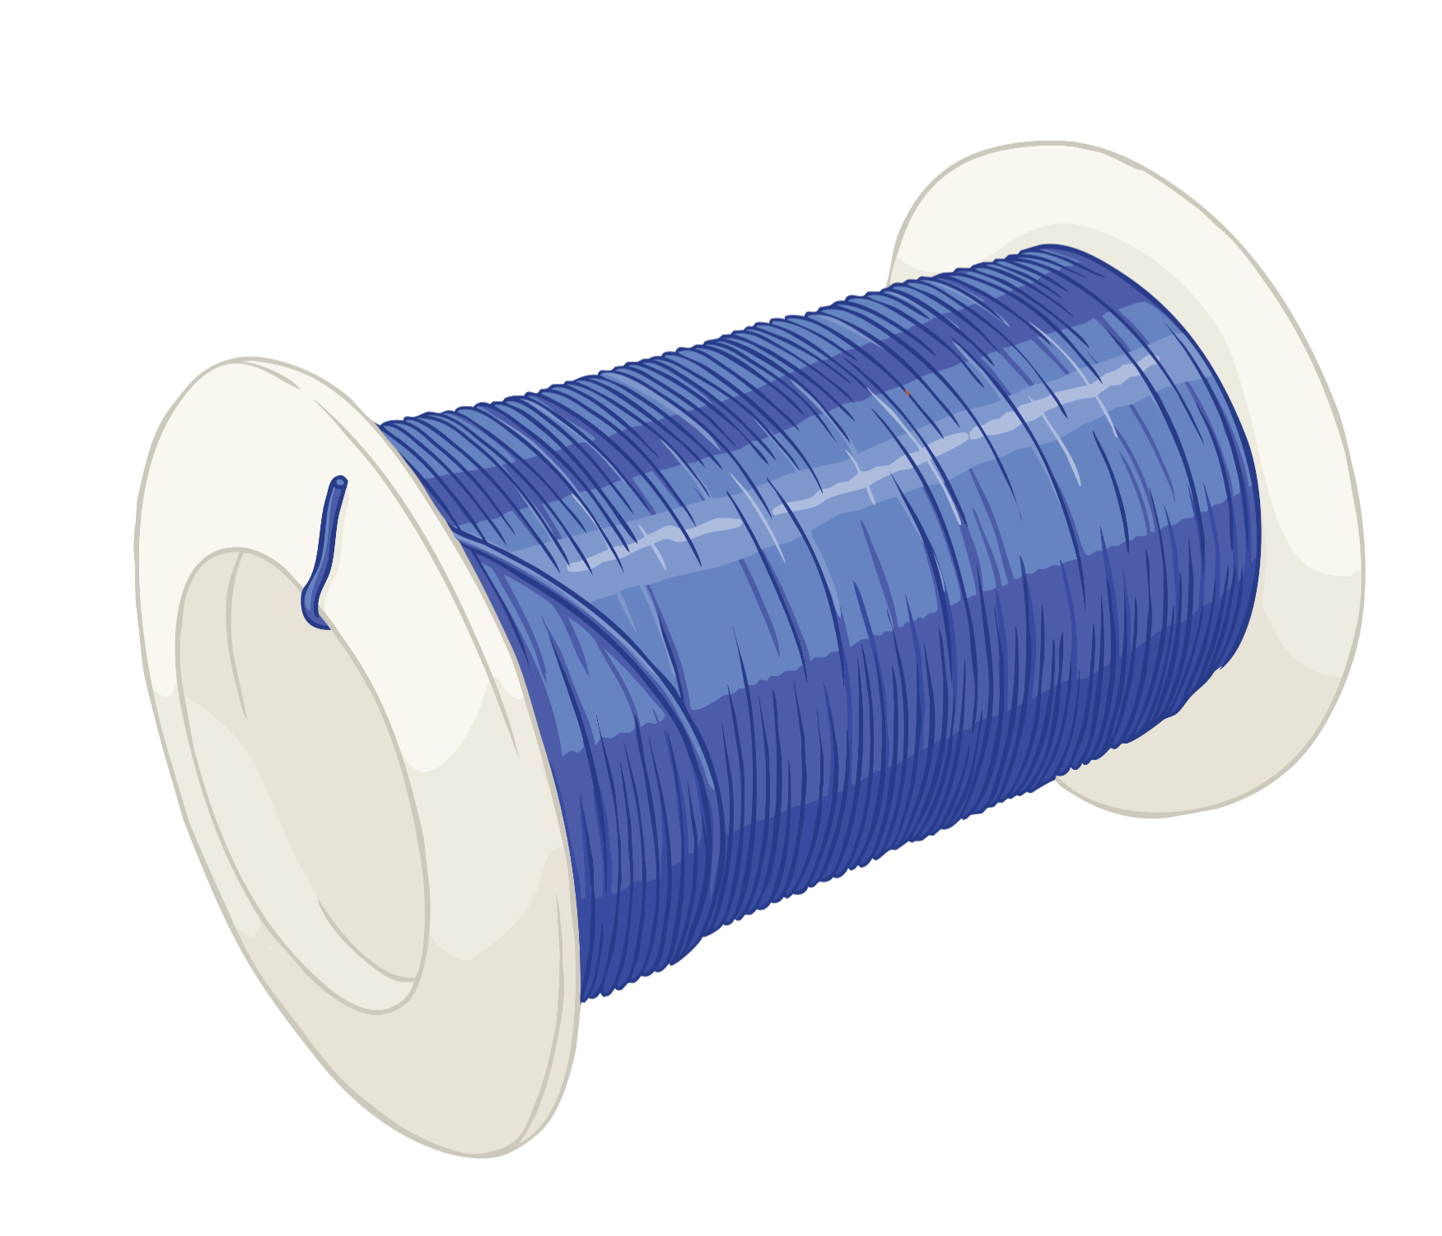
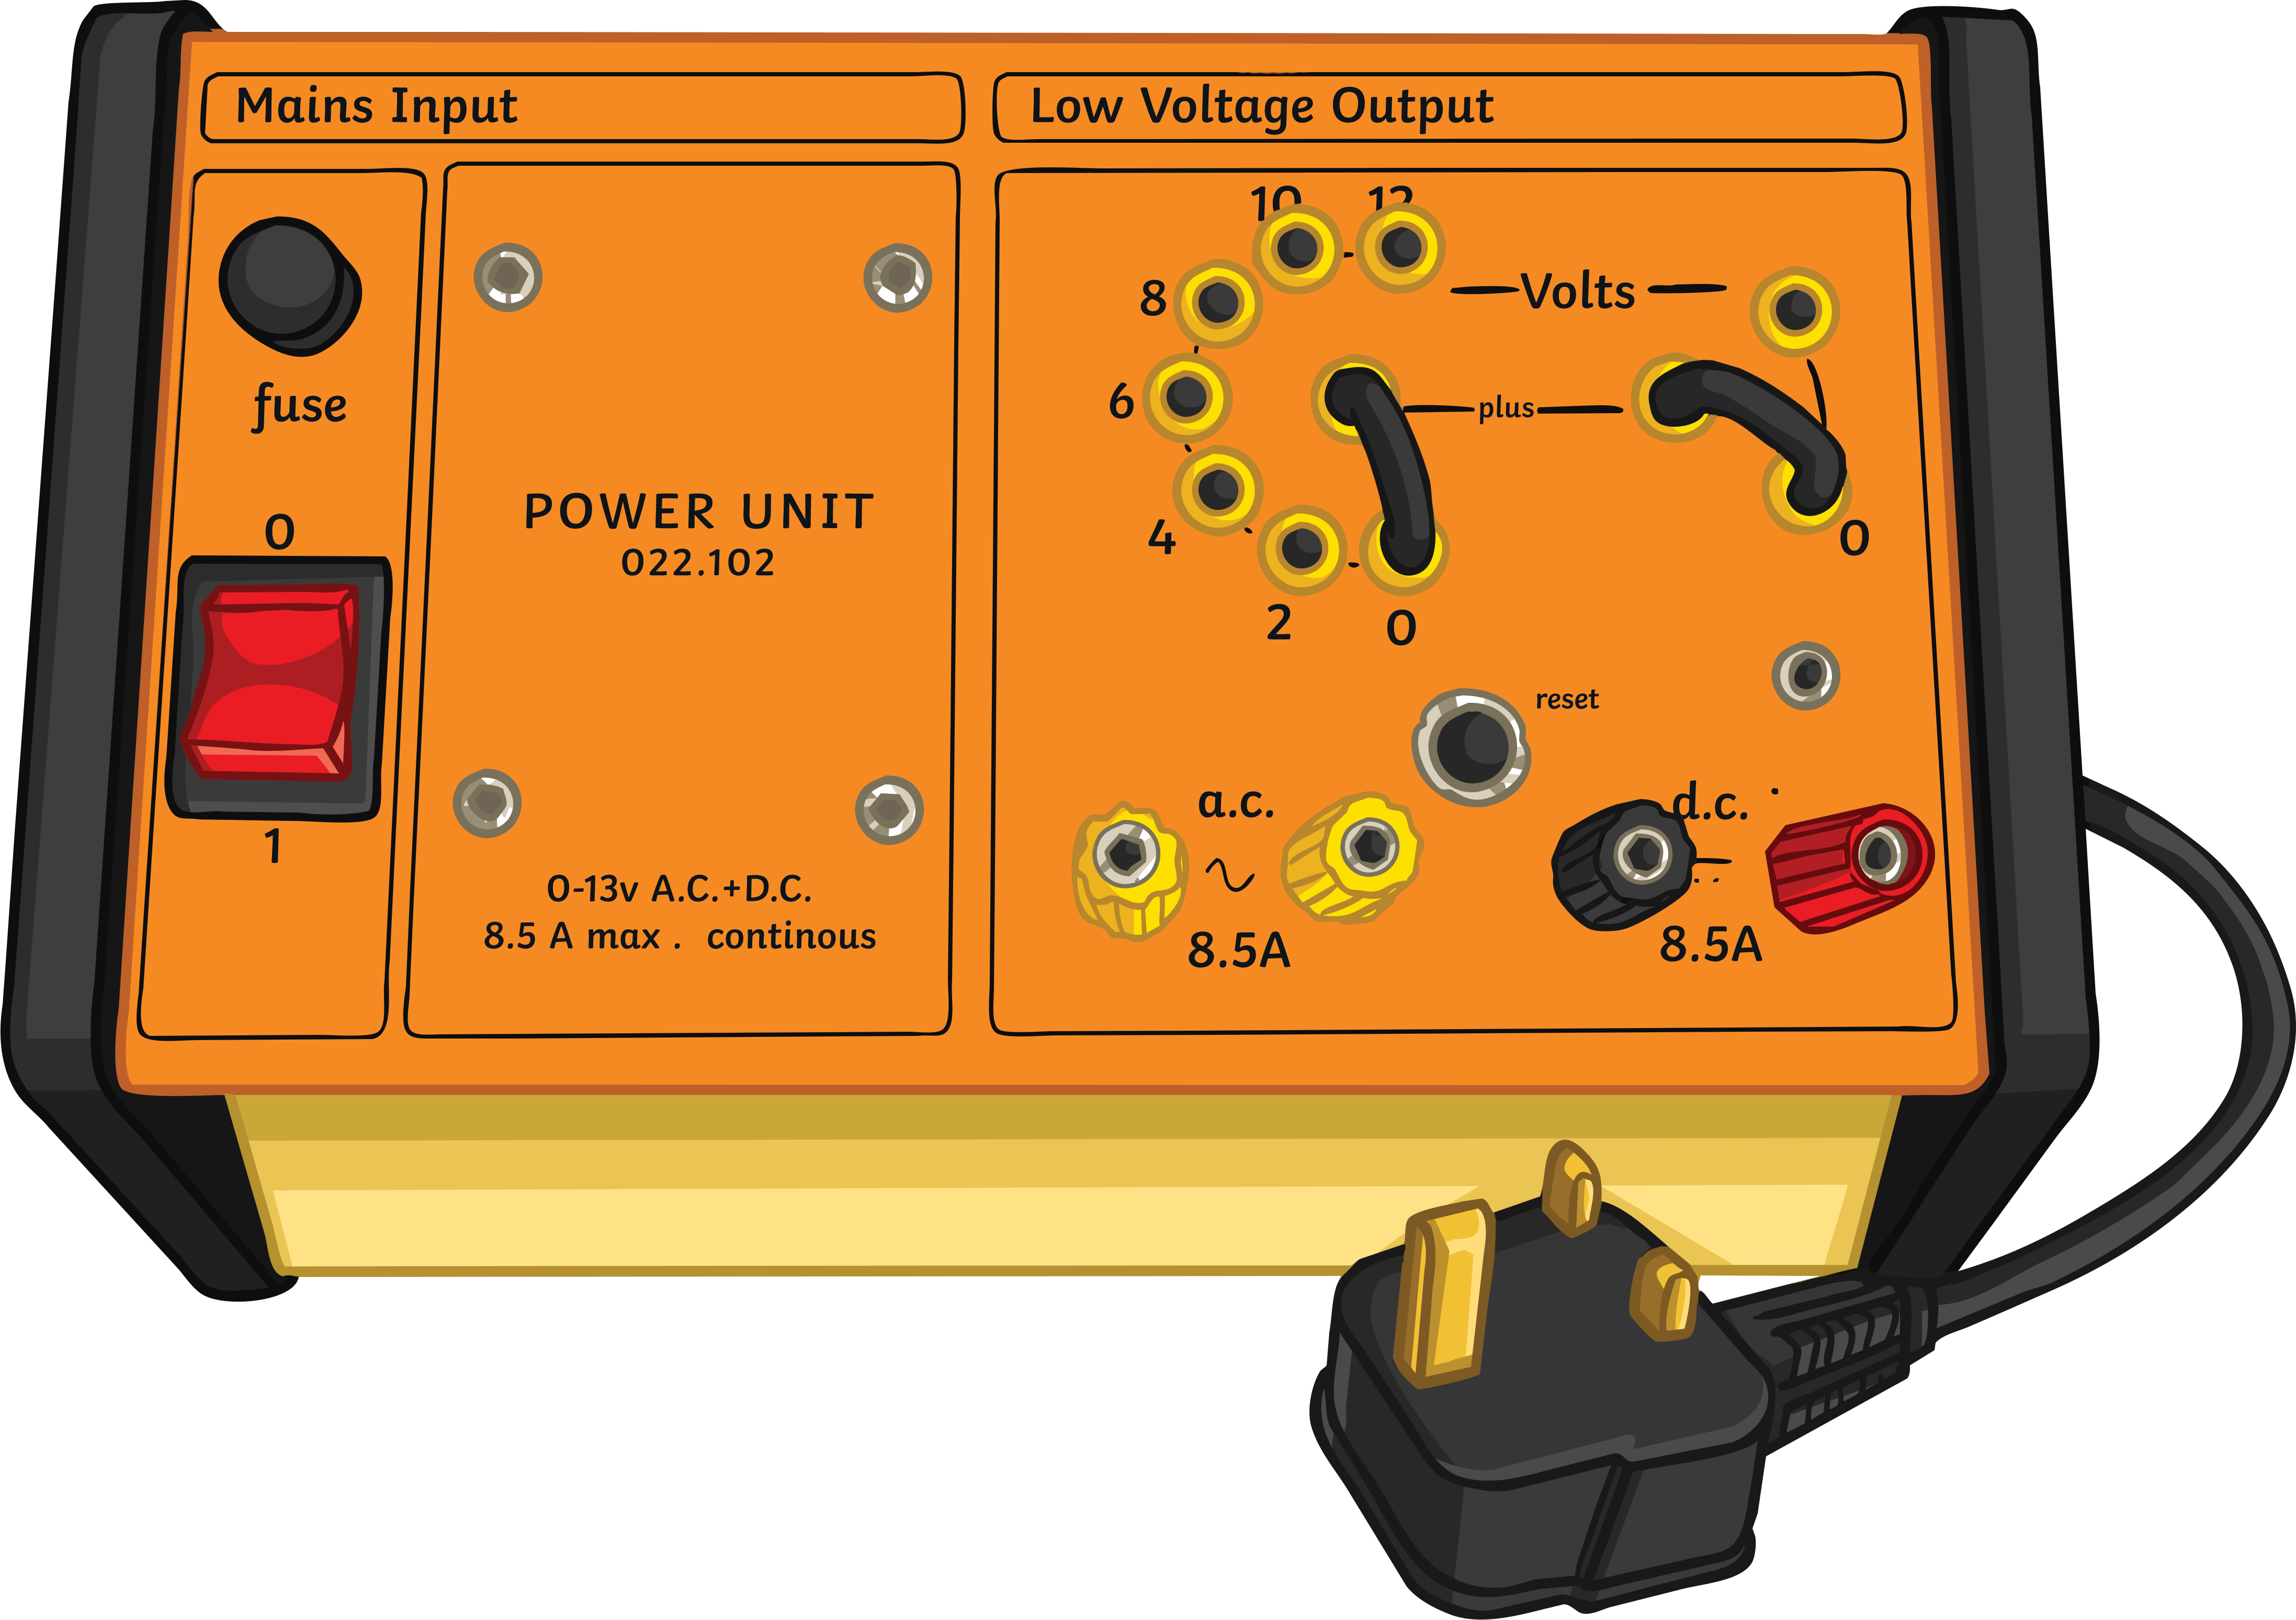
Resistance Investigation
You have been given the following equipment. How could you use it to test resistance in each of the lengths of wire?
How do we calculate resistance?
resistance (Ω) = voltage (V) ÷ current (A)

Slide 8
Resistance Investigation
What is the aim of the investigation?
Make a prediction about what you think might happen. Will the length of the wire affect the amount of current that flows through it?
When writing a method, remember to make each step as clear as possible. Imagine that you are going to give the method to a teacher who has no knowledge of the subject. Could the teacher repeat the method based on your instructions?
For example:
Method 1 – Making a cup of tea.
Step 1 – Pour the hot water into the cup.
Step 2 – Put the tea bag in the cup.
Step 3 – Put the milk in and drink.
Method 2 – Making a cup of tea.
Step 1 – Place 200ml of water into the kettle. Switch the kettle on and wait for it to boil.
Step 2 – Place one tea bag in a cup. Once the kettle has boiled, pour 200ml of boiling water into the cup.
Step 3 – Pour 5ml of milk into the cup. Stir with a teaspoon and drink.
What are the good and bad points about each method?

Slide 9

The Investigation Method
In your groups, you will need to collect the following pieces of equipment:
1 power pack, five different lengths of copper wire (20, 40, 60, 80, 100cm), crocodile clips, three circuit wires and an ammeter.
Step 1 – Collect the equipment.
Step 2 – Attach two of the circuit wires to the power pack. Place the opposite
end of one of the wires that is attached to the power pack into the
ammeter.
Step 3 – Attach the remaining circuit wire to the ammeter.
Step 4 – Place the crocodile clips onto each end of the circuit
wires that are not connected to anything.
Step 5 – Place the crocodile clips onto each end of the copper wire.
Step 6 – Set the power pack to 3V. Warning: when the
power pack is switched on, the wires can become
hot. Take the reading from the ammeter swiftly
and then turn the power pack off. Do not leave
it on as it may melt the wire.

Slide 10
Conclusion and Evaluation
Conclusion
What did you find out from the practical investigation?
Remember when writing a conclusion, you should use examples from your results to support your written work.
Evaluation
How could you improve the practical for next time?
What was the biggest difficulty you had with this experiment and how could you overcome it?
What would be the advantage of comparing your results with other people’s?

Slide 11

Extension – Resistance Graph
Once you have calculated the resistance for each length of wire, you are able to plot a resistance graph.
Resistance (Ω)
Length of Wire (cm)

Slide 12
Crazy 8: What’s the Word?
1. When opposite charges pull towards each other.
attract
2. When all the components are organised as a single loop.
series
3. When all the components are organised over more than
one loop or across branches.
parallel
4. The measure of how easy it is for a flow of charges to
pass through a component.
resistance
5. When like charges push against one another.
repel
6. The push given by a battery.
voltage
7. A material that allows a flow of charges to pass through it.
conductor
8. A material that does not allow a flow of charges to pass
through it.
insulator

